Slide 1
Practical Session {
federated_learning.py
Advanced Federated Learning with PyTorch and Flower
Cătălin Chiru & Mihai Nan
}
AI for TRUSTWORTHY DECISION MAKING

Slide 2
Introduction to Federated Learning
federated_learning.py
Federated Learning (FL) enables training machine learning models directly on user devices without transferring sensitive data to a central server. Key applications include:
Healthcare: protecting patient data
Finance: maintaining transaction confidentiality
Mobile Apps: learning from user behavior locally
Why Flower?
Flower is an open-source framework for building and simulating federated learning experiments. Its main benefits:
Supports multiple frameworks: PyTorch, TensorFlow, JAX
Scalable and flexible design
Provides tools for efficient simulation and evaluation
AI for TRUSTWORTHY DECISION MAKING

Slide 3
Federated Learning in 5 steps {
01
federated_learning.py
Send model to a number of connected devices (client nodes)
02
Train model locally on the data of each device
03
Return model updates back to the server
04
Aggregate model updates into a new global model
05
Repeat steps 1 to 4 until the model converges
}
- suggestion - A Survey on Federated Learning Systems: Vision, Hype and Reality for Data Privacy and Protection, 2021, https://arxiv.org/abs/1907.09693
AI for TRUSTWORTHY DECISION MAKING

Slide 4
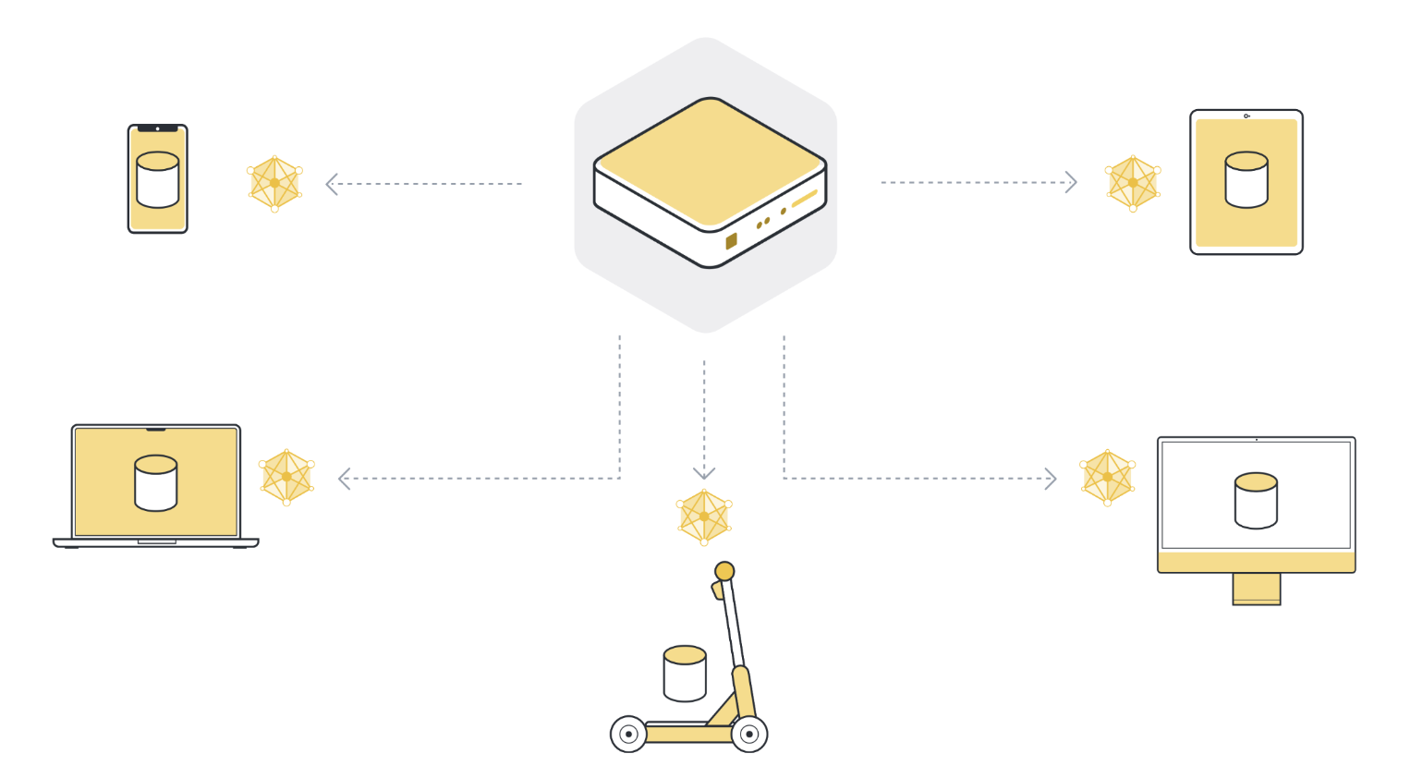
01 {
federated_learning.py
}
AI for TRUSTWORTHY DECISION MAKING

Slide 5

02 {
federated_learning.py
}
AI for TRUSTWORTHY DECISION MAKING

Slide 6
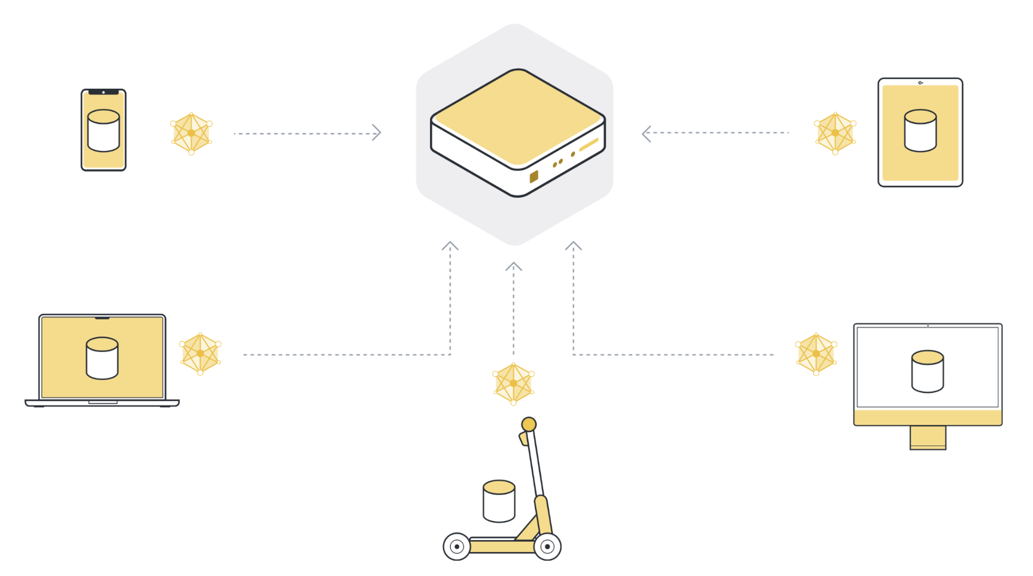
03 {
federated_learning.py
}
AI for TRUSTWORTHY DECISION MAKING

Slide 7

04 {
federated_learning.py
}
AI for TRUSTWORTHY DECISION MAKING

Slide 8
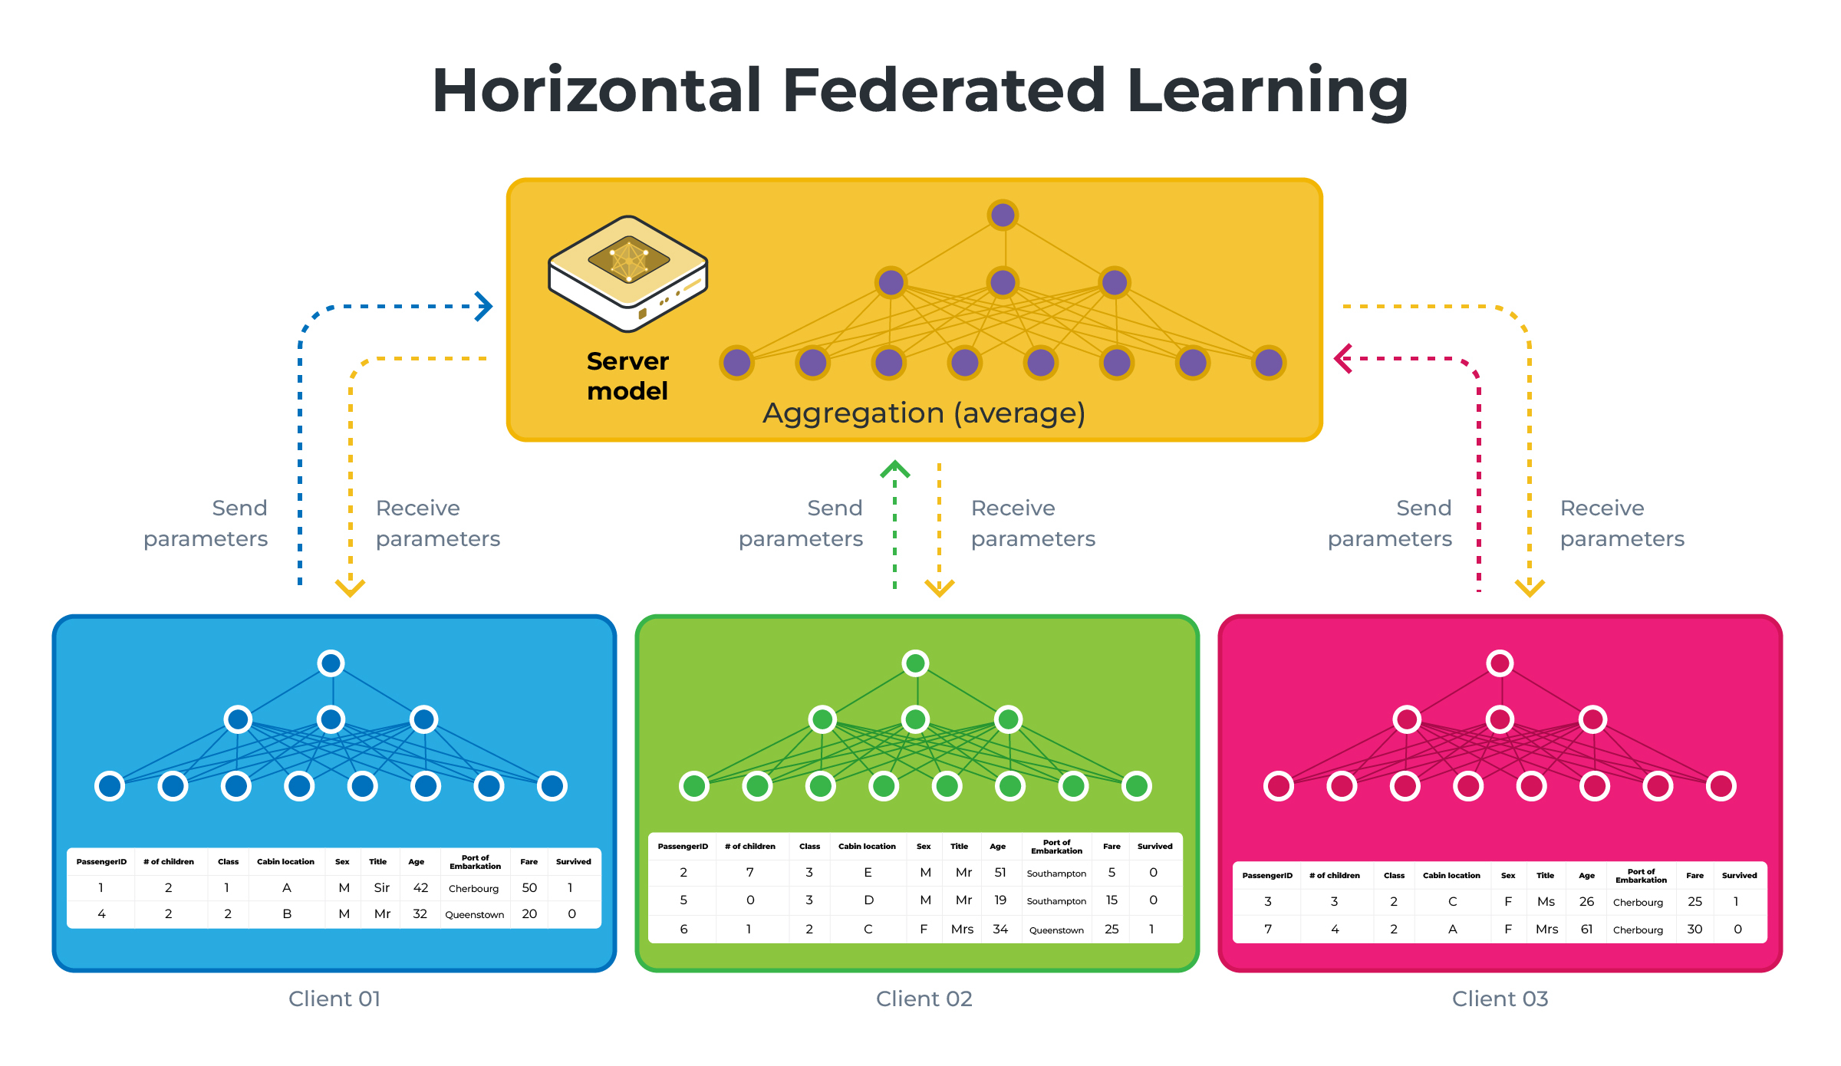
Horizontal Federated Learning {
federated_learning.py
}
AI for TRUSTWORTHY DECISION MAKING

Slide 9
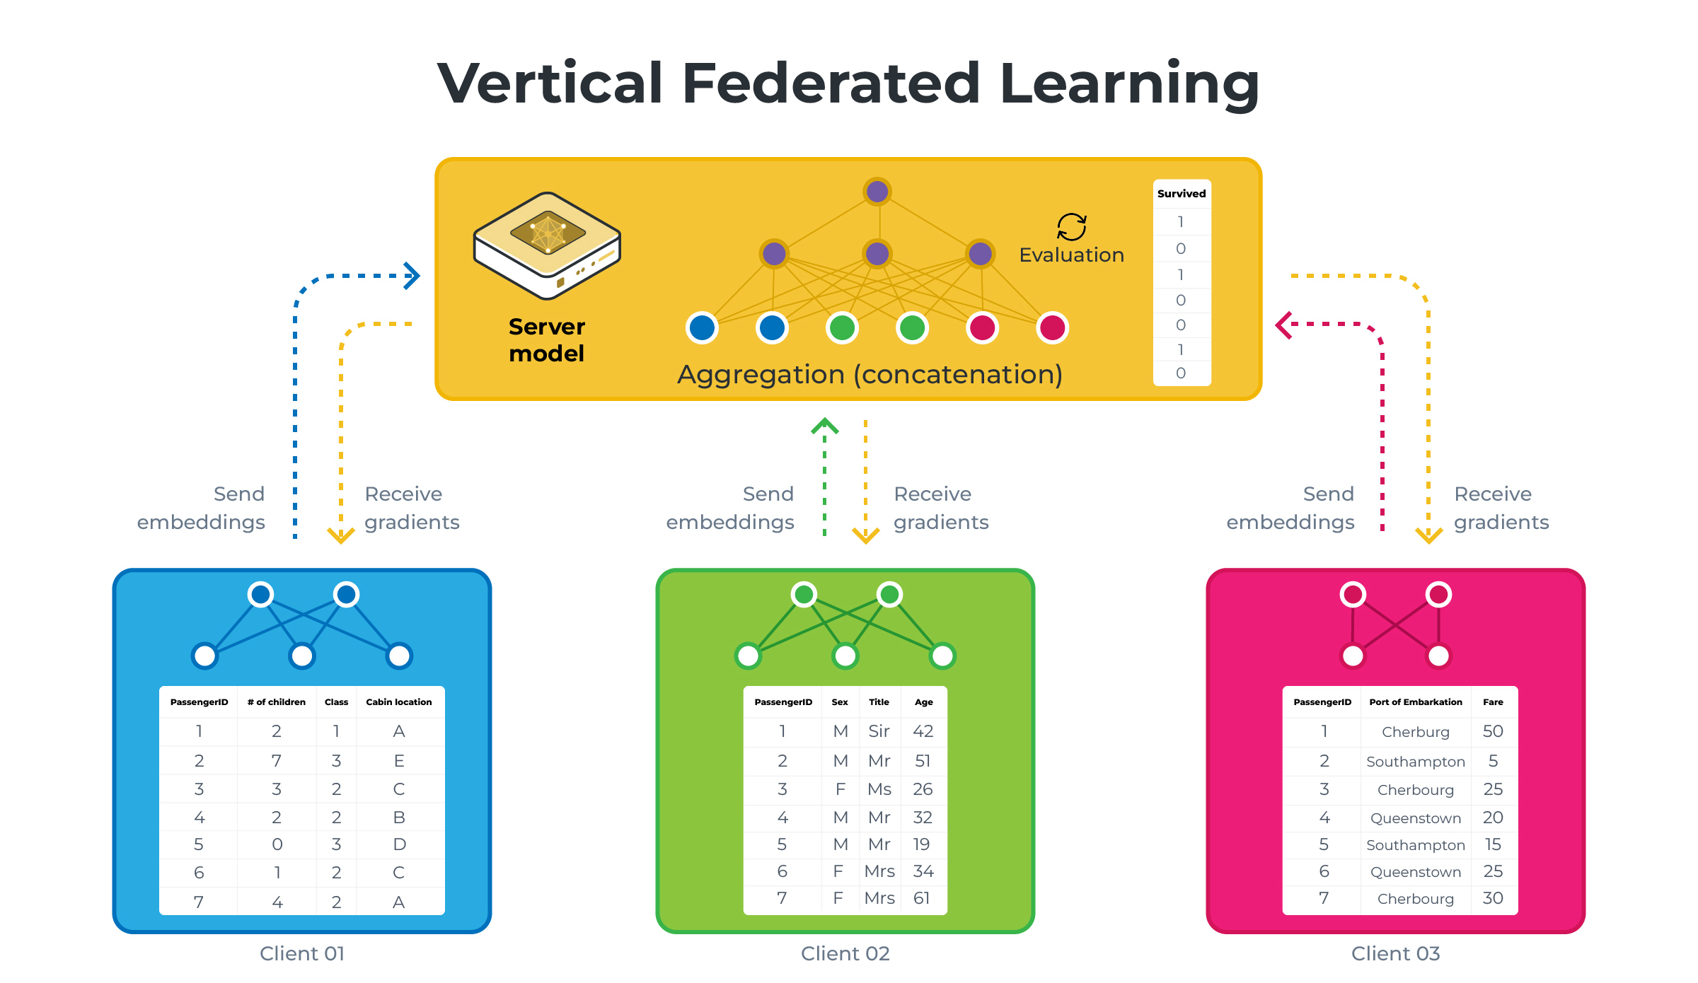
Vertical Federated Learning {
federated_learning.py
}
AI for TRUSTWORTHY DECISION MAKING

Slide 10
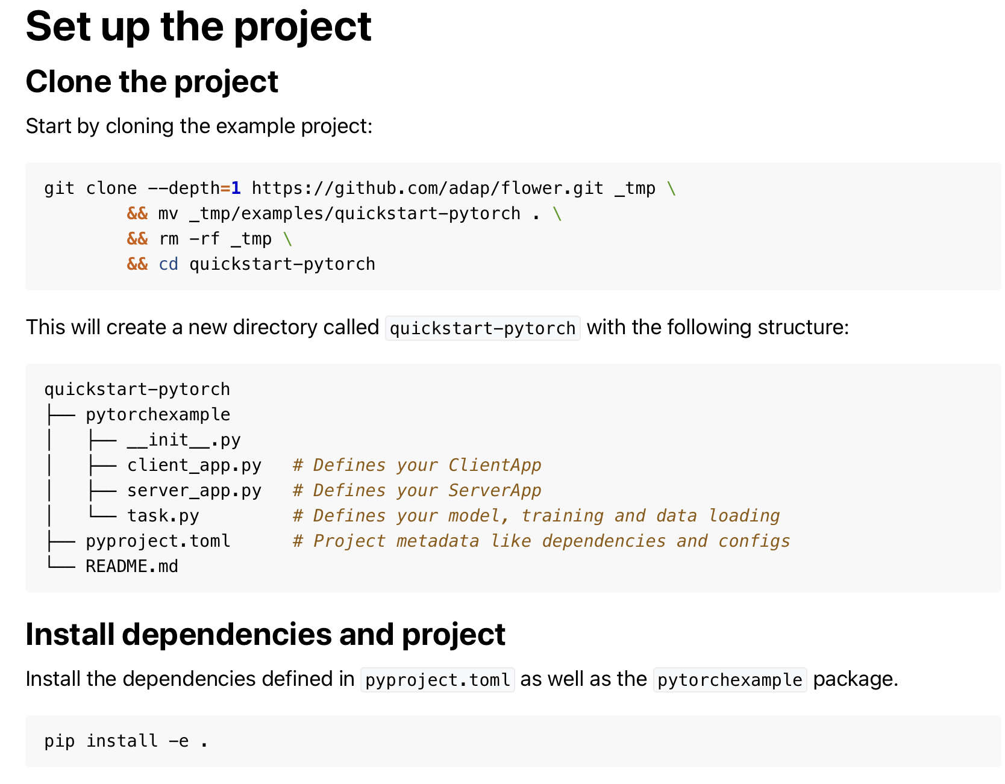
Federated Learning with PyTorch {
federated_learning.py
}
AI for TRUSTWORTHY DECISION MAKING

Slide 11
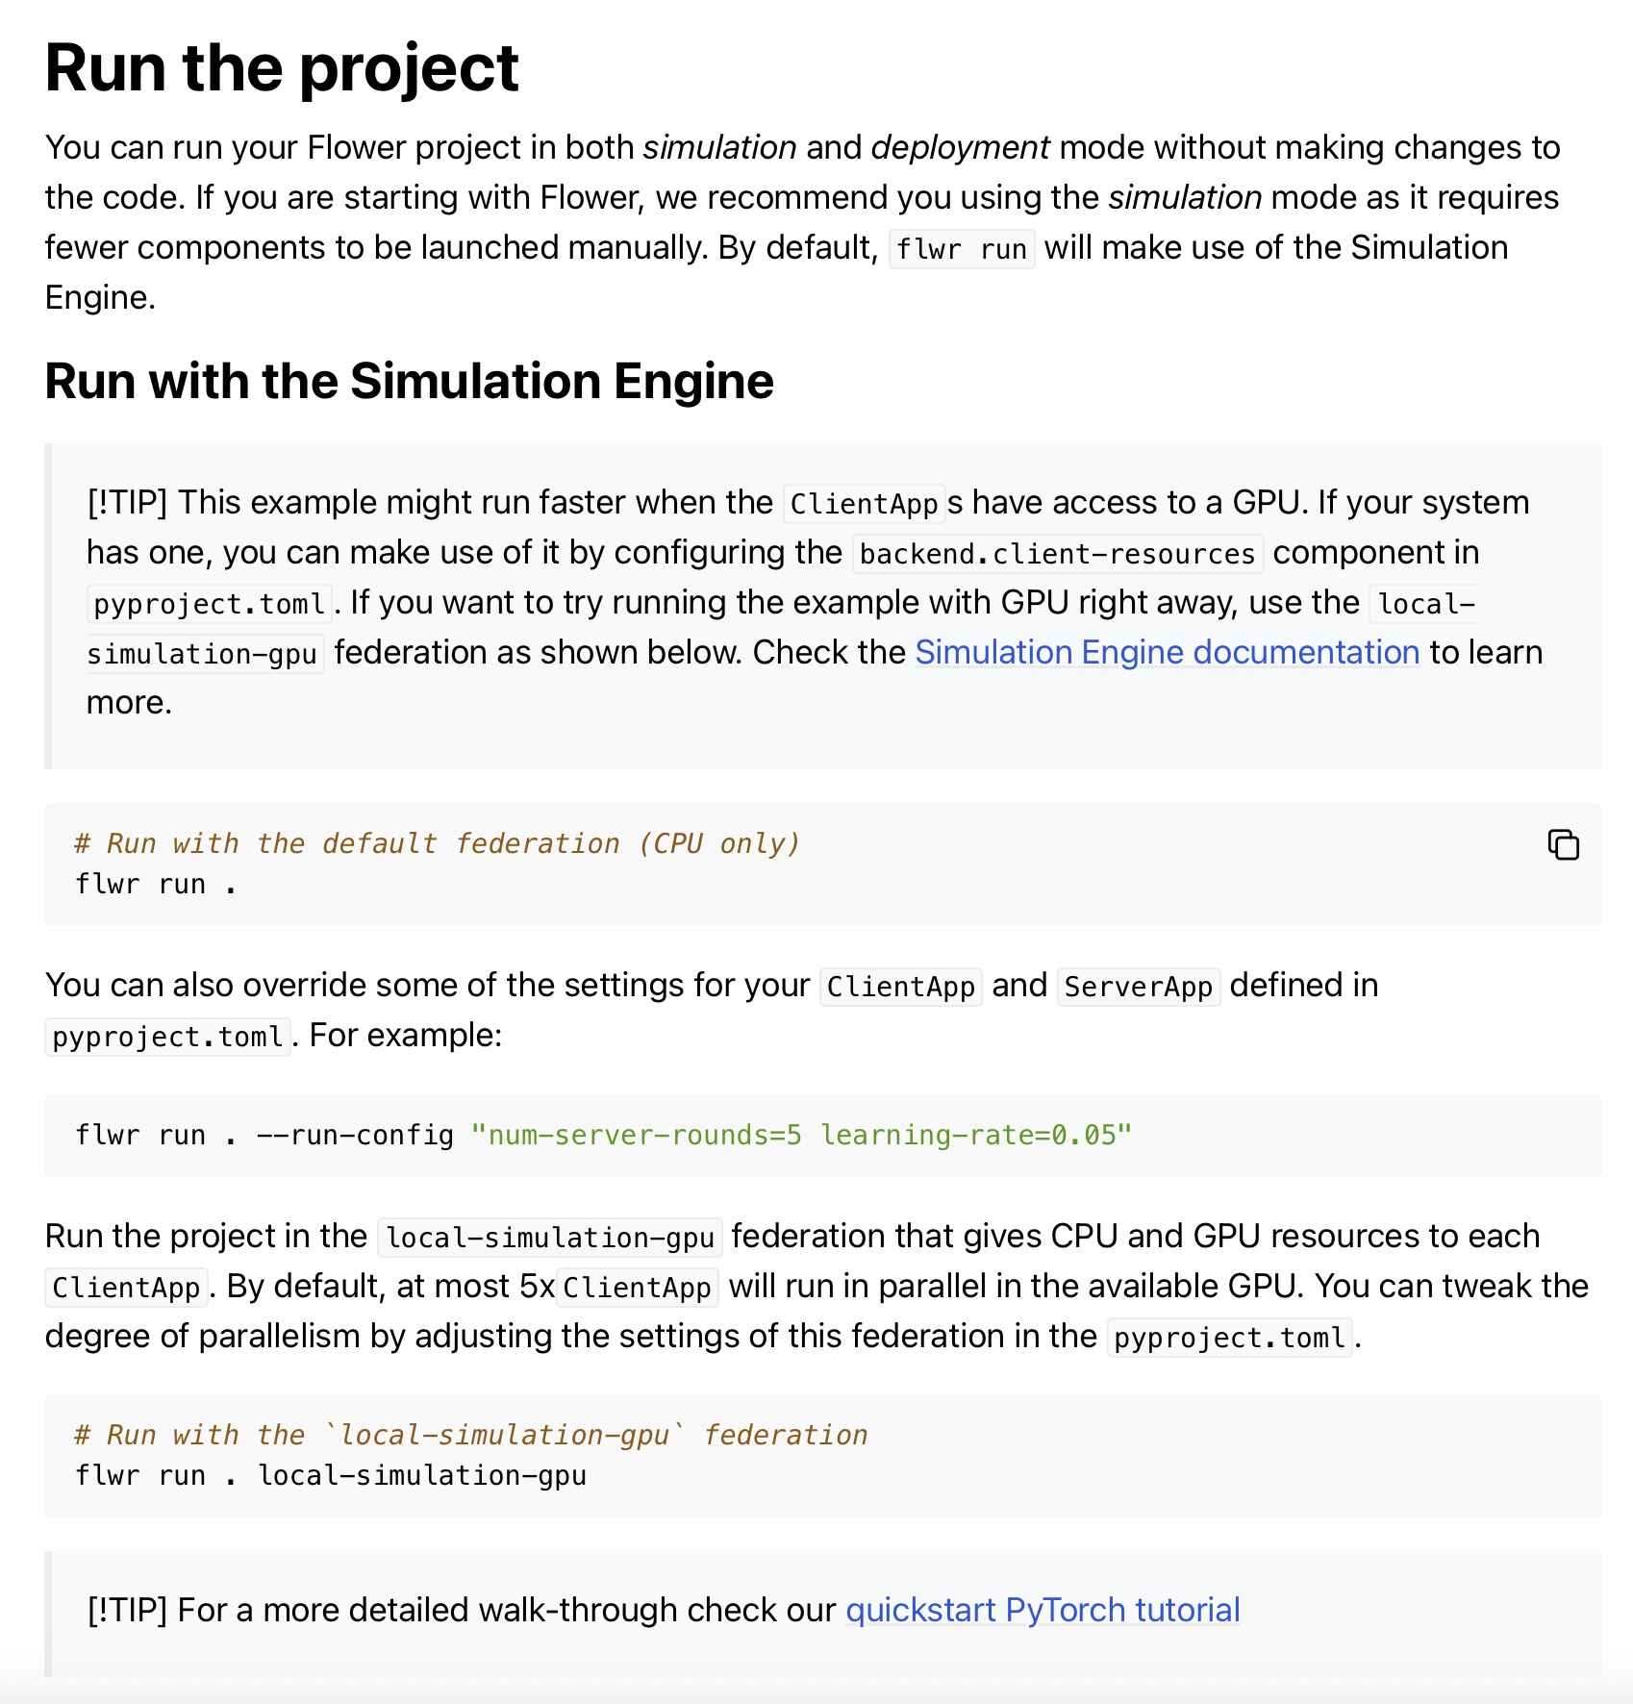
Federated Learning with PyTorch {
federated_learning.py
}
AI for TRUSTWORTHY DECISION MAKING

Slide 12
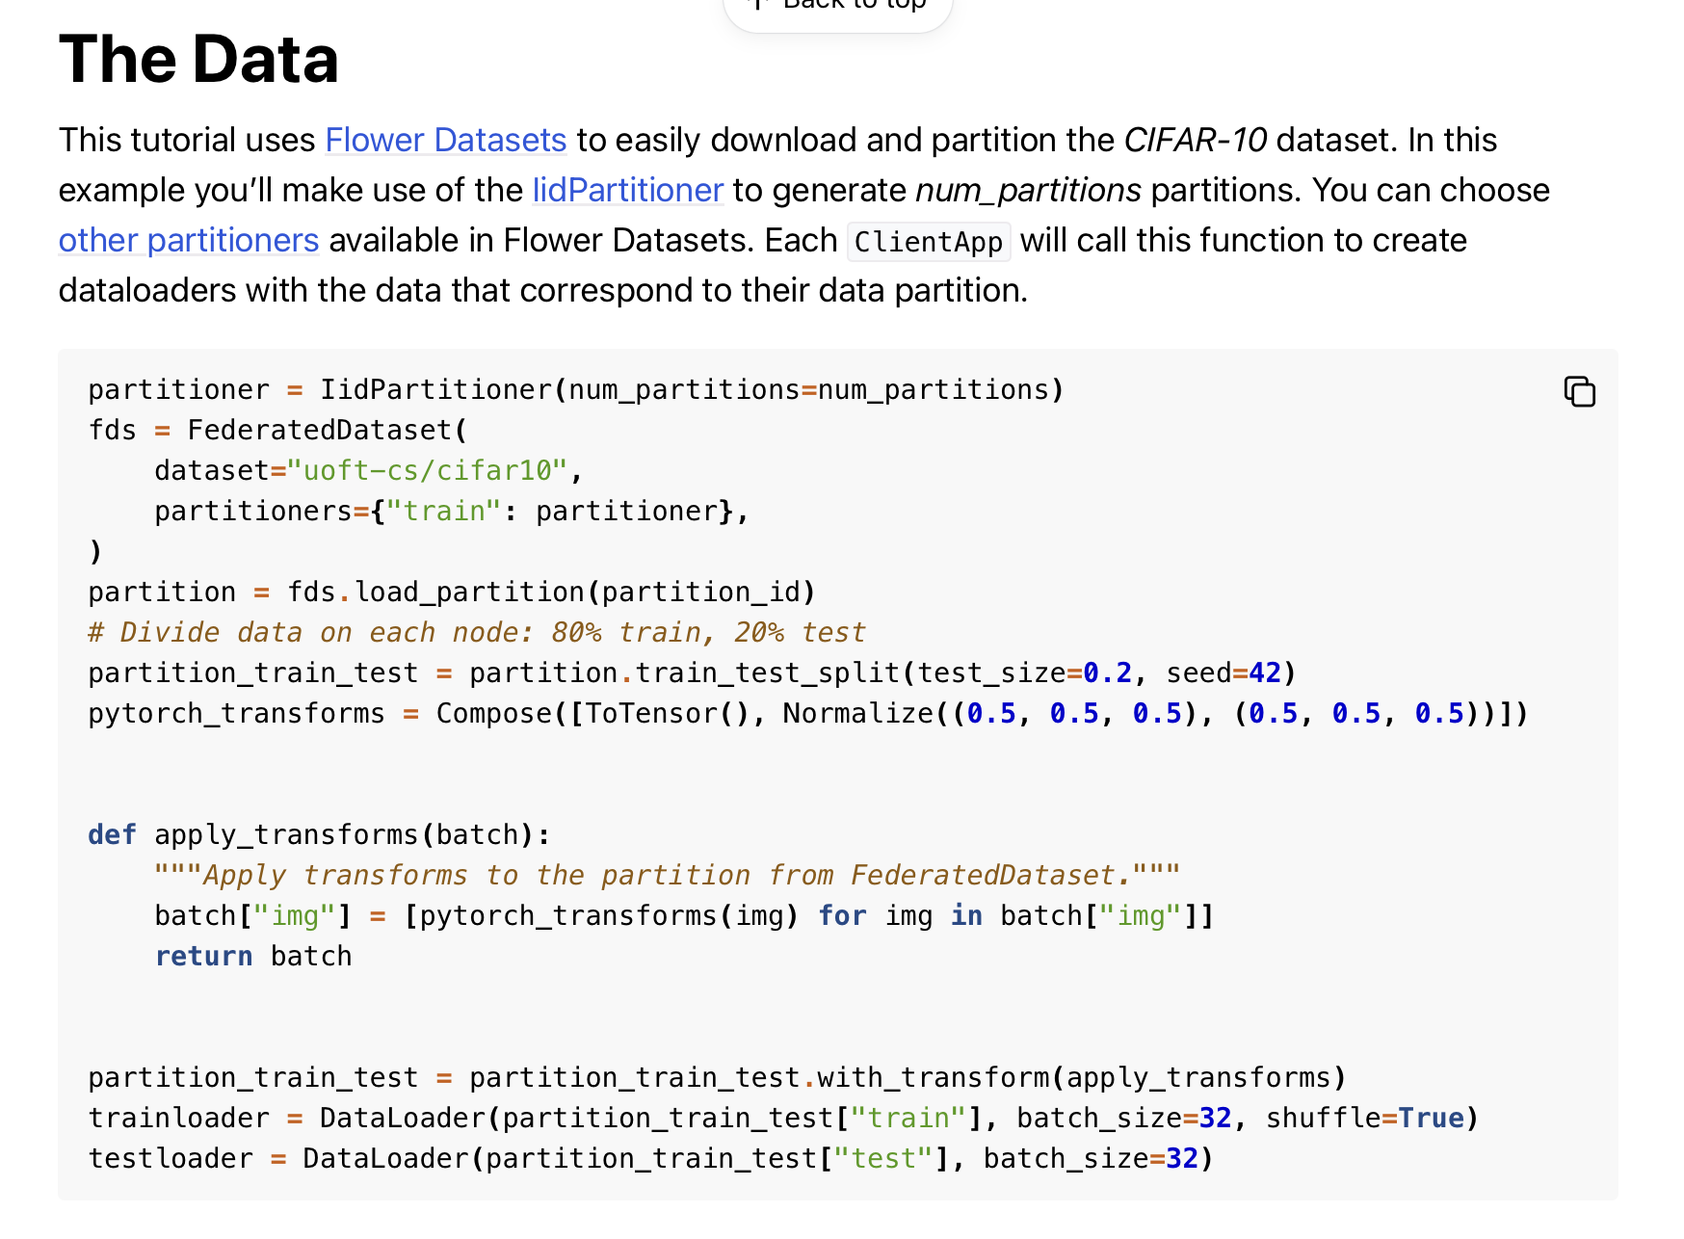
Federated Learning with PyTorch {
federated_learning.py
}
AI for TRUSTWORTHY DECISION MAKING

Slide 13
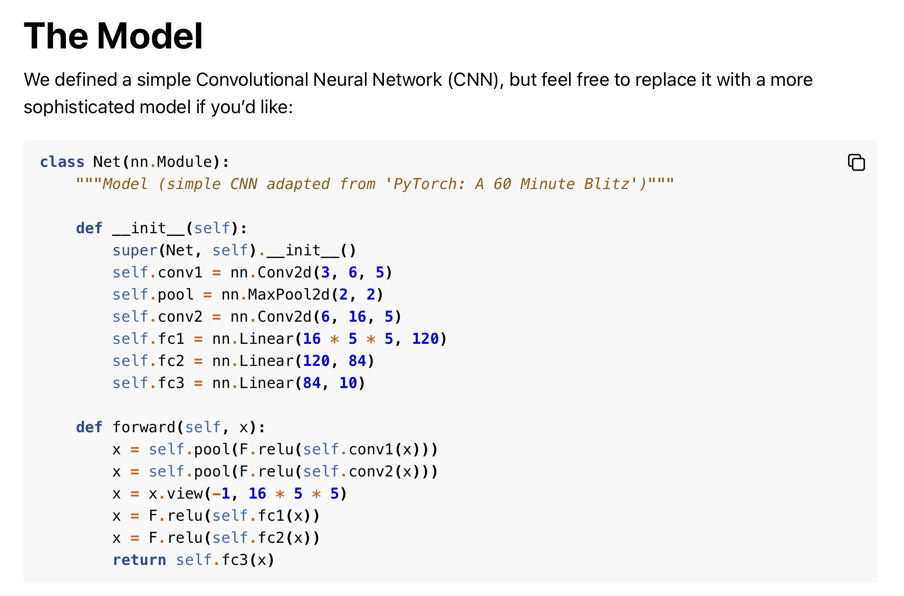
Federated Learning with PyTorch {
federated_learning.py
}
AI for TRUSTWORTHY DECISION MAKING

Slide 14
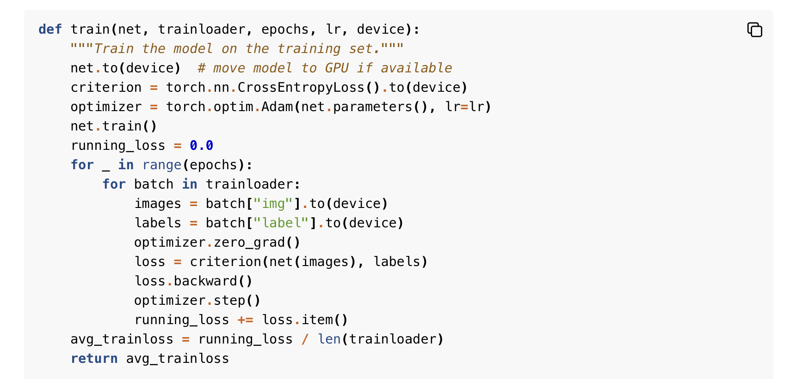
Federated Learning with PyTorch {
federated_learning.py
}
AI for TRUSTWORTHY DECISION MAKING

Slide 15
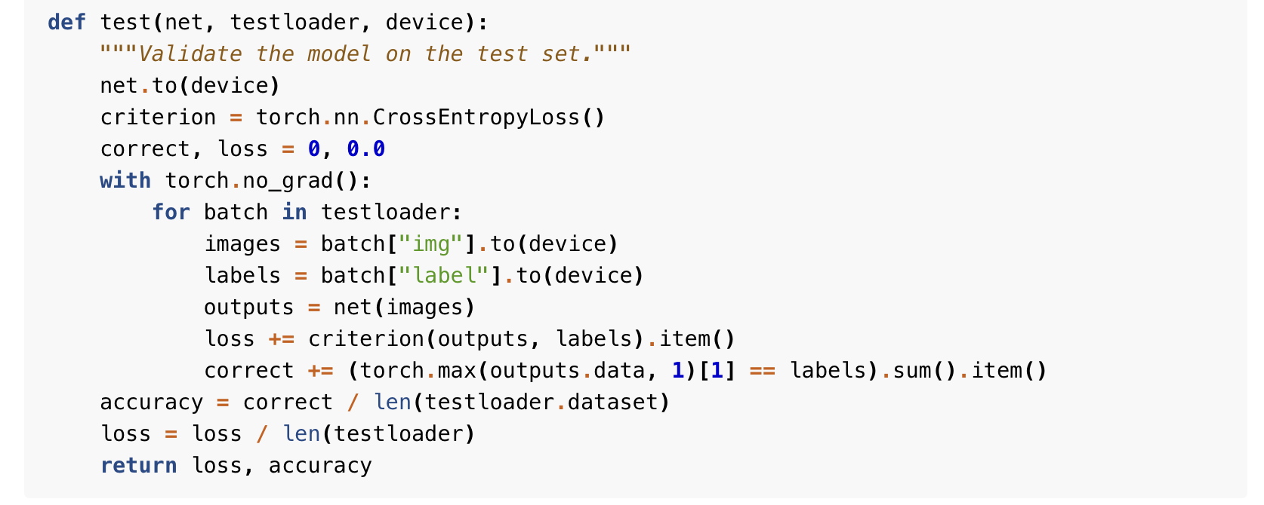
Federated Learning with PyTorch {
federated_learning.py
}
AI for TRUSTWORTHY DECISION MAKING

Slide 16
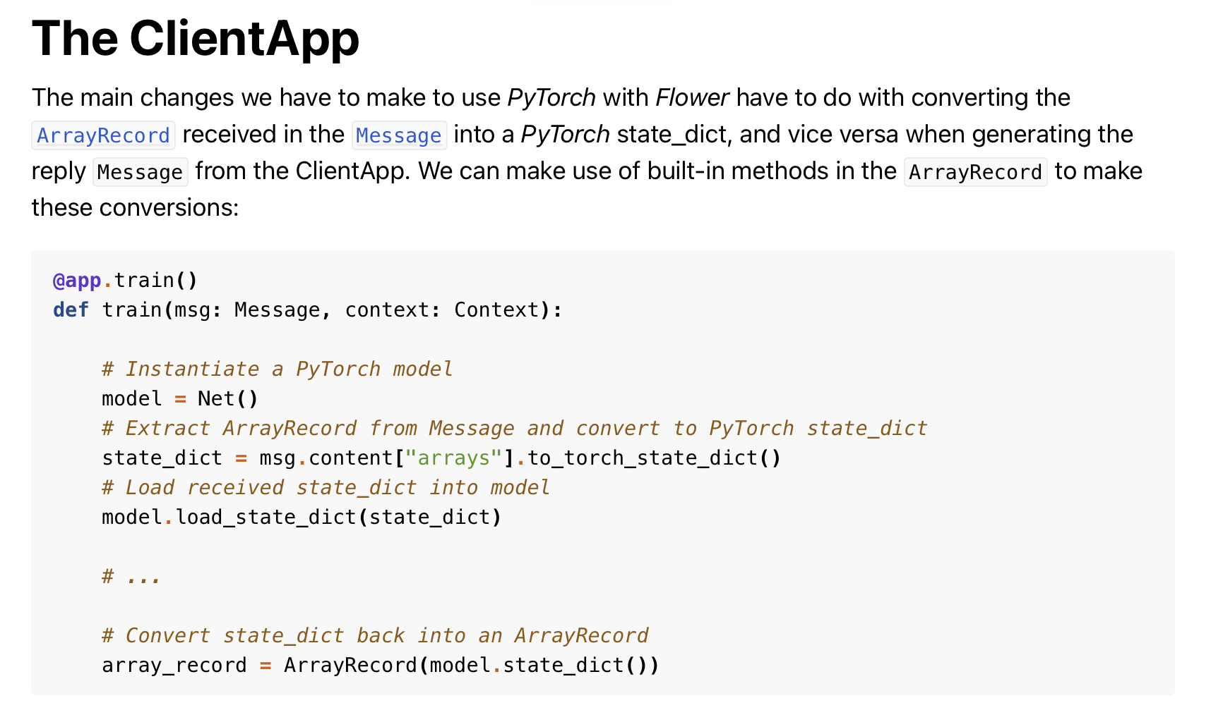
Federated Learning with PyTorch {
federated_learning.py
}
AI for TRUSTWORTHY DECISION MAKING

Slide 17
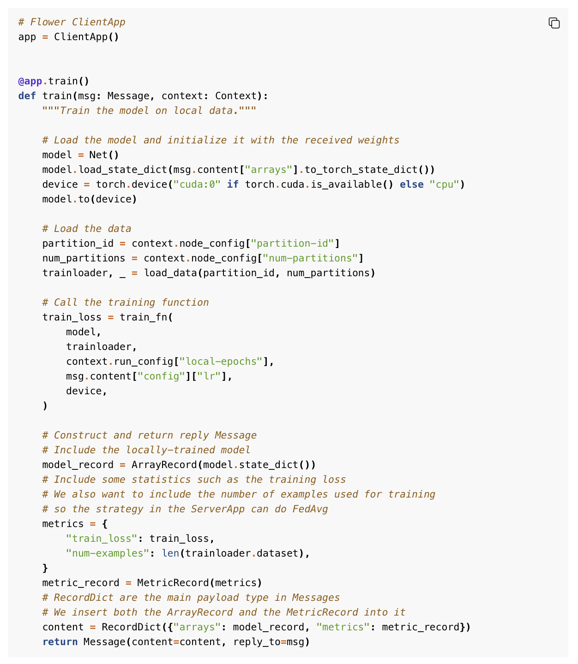
Federated Learning with PyTorch {
federated_learning.py
}
AI for TRUSTWORTHY DECISION MAKING

Slide 18
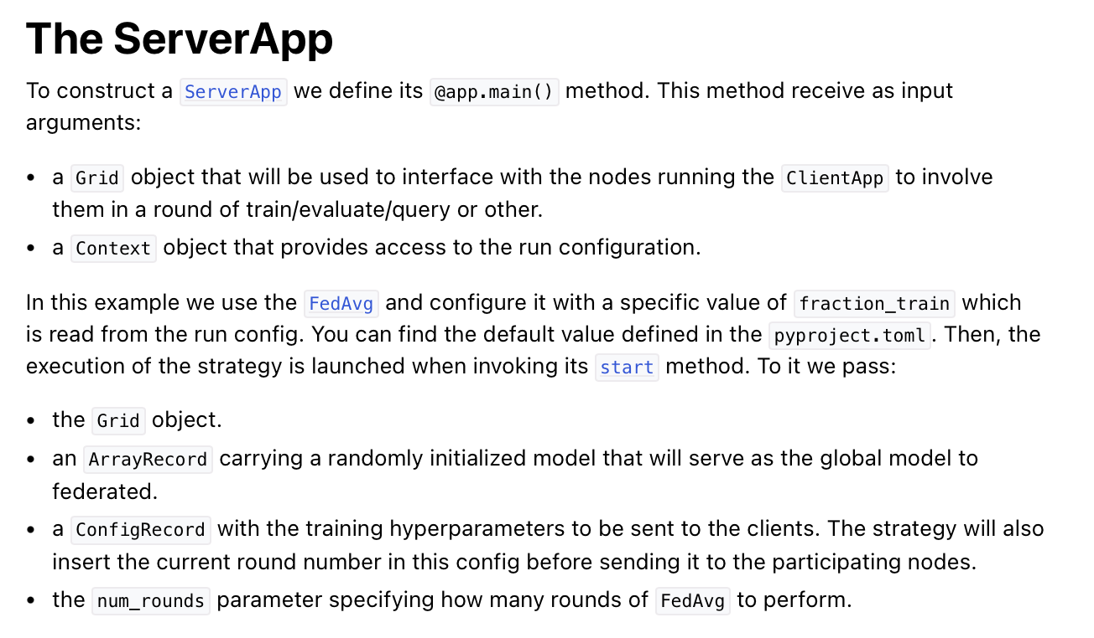
Federated Learning with PyTorch {
federated_learning.py
}
AI for TRUSTWORTHY DECISION MAKING

Slide 19
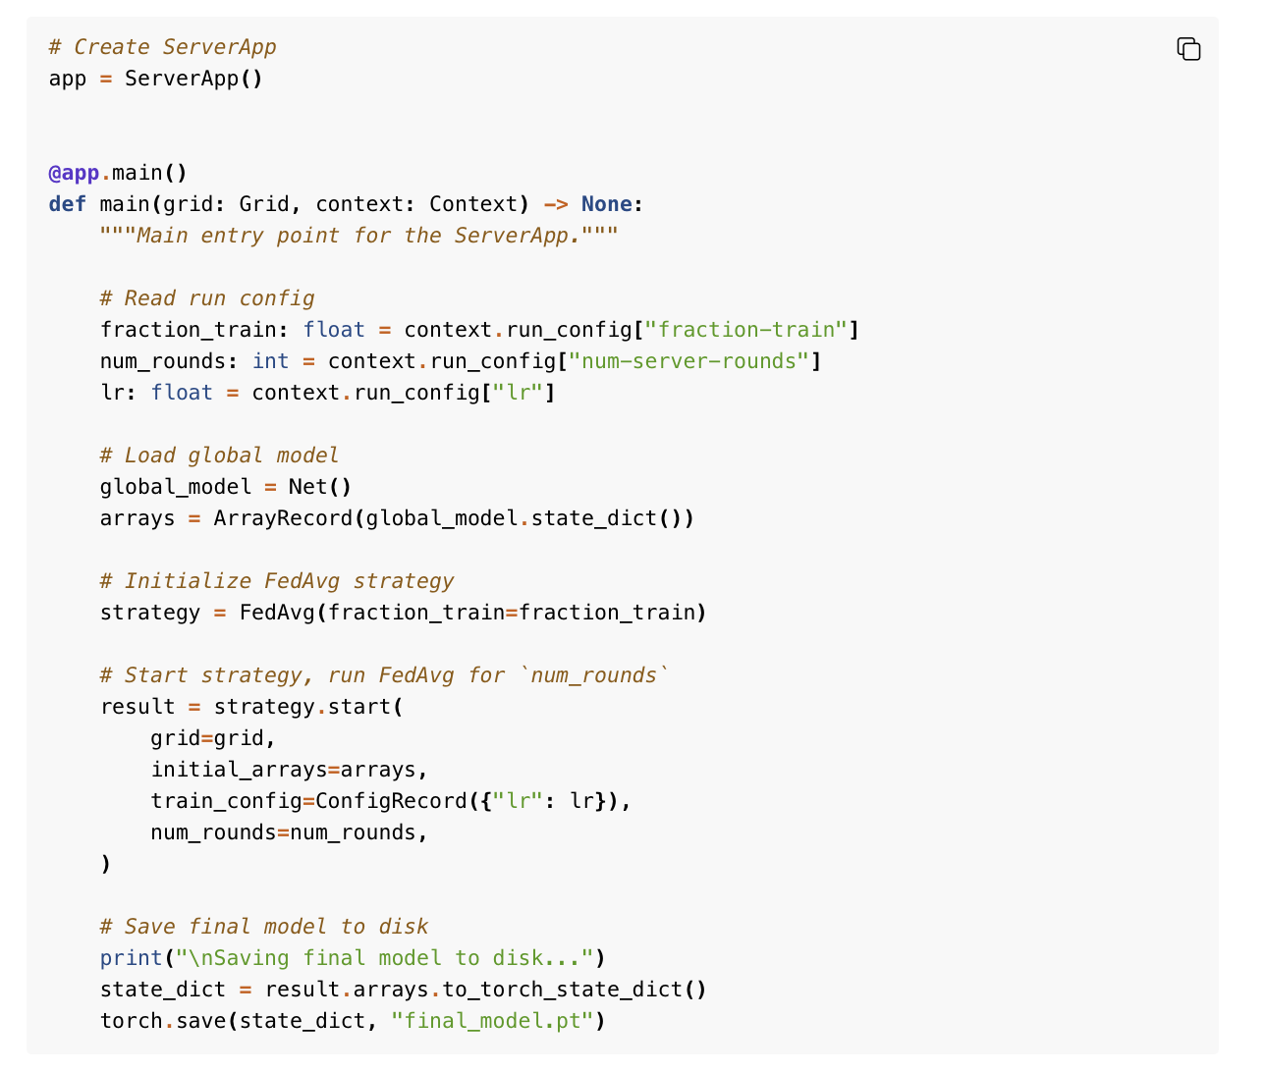
Federated Learning with PyTorch {
federated_learning.py
}
AI for TRUSTWORTHY DECISION MAKING

